Slide 1
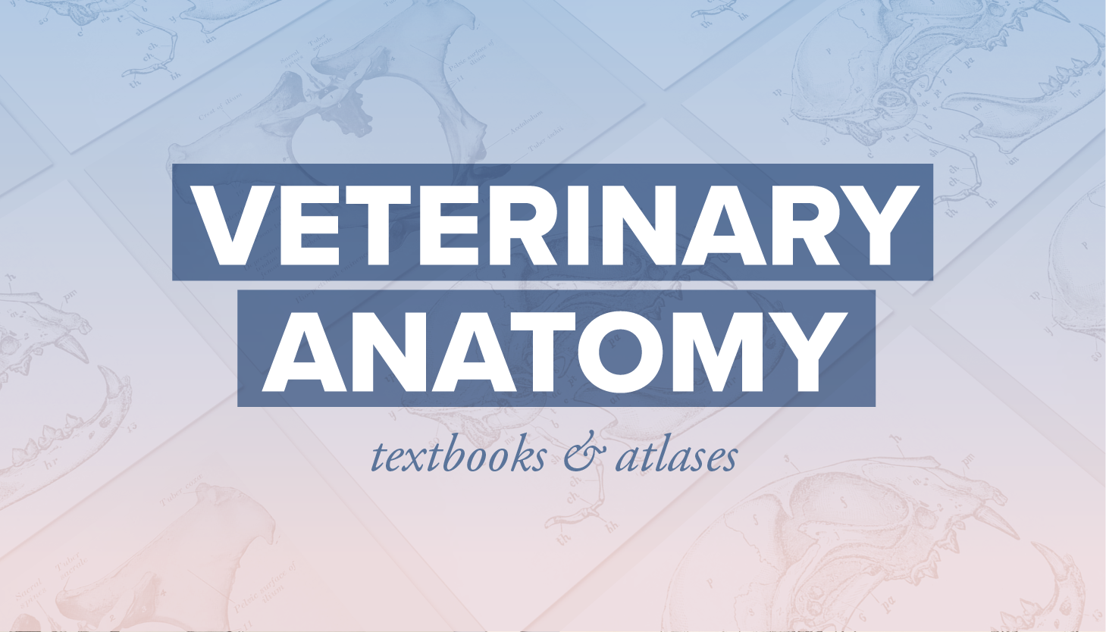

Slide 2
Parents are the best friend of our life
Dr. Abhinov
(B.V.Sc.&A.H., MVSc. & PhD)
Designation
Student of Anatomy cum Assistant Professor

Slide 3
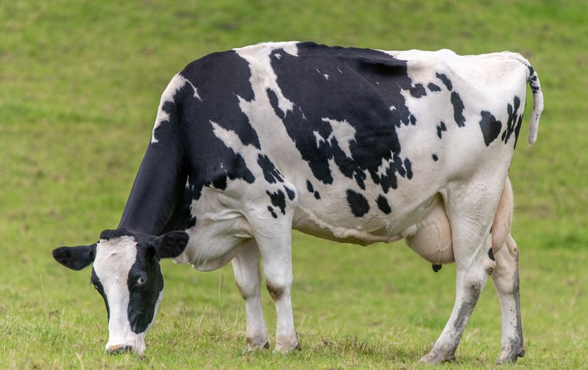

Slide 4
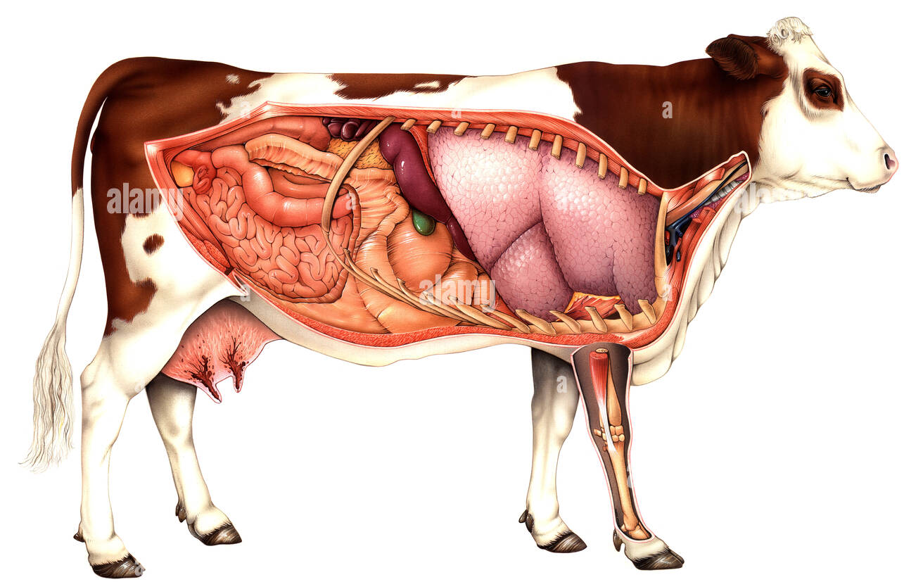
Gross Anatomy

Slide 5
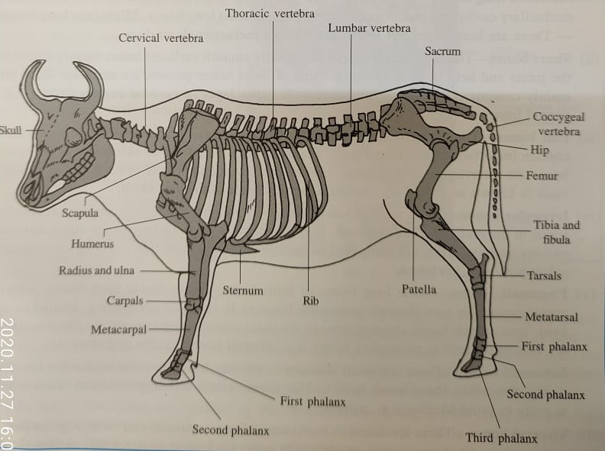
Veterinary Anatomy (Credit Hrs= 4+3)
Divided into 08 Units-
Unit 1- Introduction, Definitions ,Descriptive terms and general description of various branches.
Unit 2- Forelimb
Unit 3- Head and neck
Unit 4- Thorax
Unit 5- Abdomen
Unit 6 – Hind limb and pelvis
Unit 7- Histology
Unit 8- Embryology

Slide 6
Class-I

Slide 7
Veterinary Anatomy (Credit Hrs= 4+3)
Divided into 08 Units- (03 internal + 01 external exam)
Unit 1- Introduction, definitions, general description of various branches, topographic terms, general osteology and descriptive terms.
Unit 2- Forelimb
Unit 3- Head and neck
Unit 4- Thorax
Unit 5- Abdomen
Unit 6 – Hind limb and pelvis
Unit 7- Histology
Unit 8- Embryology

Slide 8
TextBooks
Anatomy of Domestic animals- Robert Getty
Primary Veterinary Anatomy- R.K. Ghosh
Histo
embryo

Slide 9
Anatomy: It is of Greek origin, and is derived from Anatemnein which has the prefix Ana, that means up or apart, and temnein - means cutting. It signifies "cutting apart" or dissociating of parts of the animal body.
Prefix Ana means up or apart
Suffix temnein means cutting
Definition : It is the branch of biological science which deals with the form and structure of organisms.
Veterinary Anatomy deals with the form and structure of principal domesticated animals (i.e. ox, horse, dog and fowl etc.). As matter of convenience and necessity the ox has been selected, in India, as the type animal to be studied in detail and to form a basis of comparison of the more essential differential characters in horse, dog and fowl and other domestic animals.
.

Slide 10
Divisions/Branches of Vet.Anatomy (8)
Physiological Anatomy: It deals with structures of animals body in healthy conditions.
Pathological Anatomy: It deals with structures of animals body in diseased conditions.
Comparative Anatomy: It deals with the description and comparison of structures of different species of animals and thus form the basis for their classifications
Philosophical Anatomy studies analogies or similarities of organs of different animals.
Microscopic Anatomy or Histology: It deals with minute details of structures of the animal body. It is studied by the help of microscope
Embryology: It deals with the study of growth and differentiation undergone by an organisms during the phase of its development from a single fertilized egg to highly complex and independent organism like its parents.

Slide 11
7. Applied Anatomy: It is the consideration of anatomical facts in their relation to surgery and other clinical branches.
8. Special Anatomy: It deals with the study of the structures of a single, type or species of animals e.g.:
Hippotomy: (Hippos - Horse): Anatomy of horse
Anthropotomy (Anthros - Man): Anatomy of man.

Slide 12
Methods for Studying anatomy:
There are two chief methods of studying Anatomy.
(a) Systematic
(b) Topographic, or regional
Applied also (by Getty,2012)
Systematic Anatomy:
Under this study the body is regarded to be consisting of systems or groups of organs which are similar in origin and structure and are associated in the performance of certain functions.

Slide 13
BRANCHES OF SYSTEMATIC ANATOMY (7)
Osteology :
Deals with the description of different bones of skeleton.
(2) Syndesmology of Arthrology:
Deals with the different articulations or joints of body.
(3) Myology: It deals with the description of different muscles and their accessory structures.

Slide 14
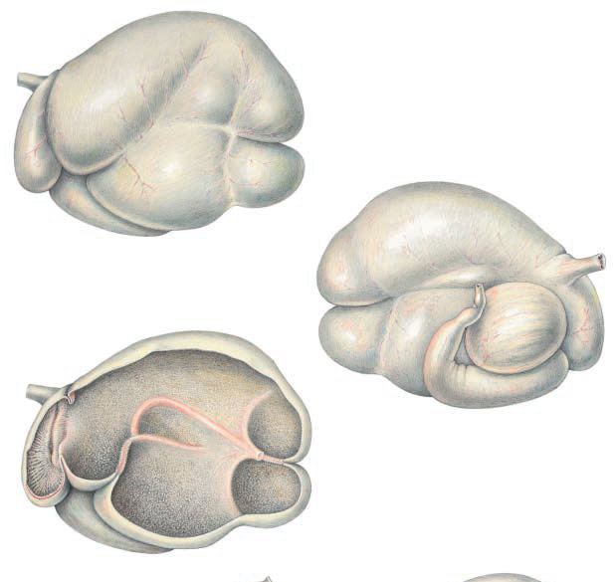
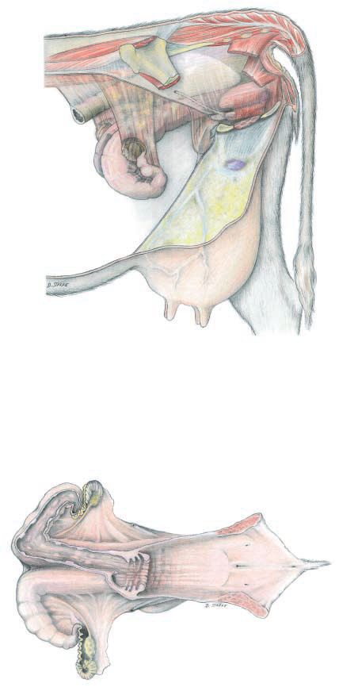
( 4) Splanchnology: It deals with the description of viscera.
Subdivisions of Splanchnology
a) Digestive system: Group of organs related to digestions.
b) Respiratory system: Group of organs related respiration.
c) Urogenital system :
(i) Urinary system: Group of organ related to manufacture of urine .
(ii) Genital system: Group organs related to reproduction.

Slide 15
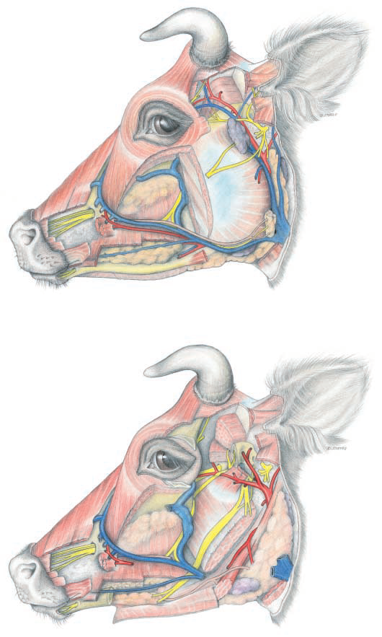
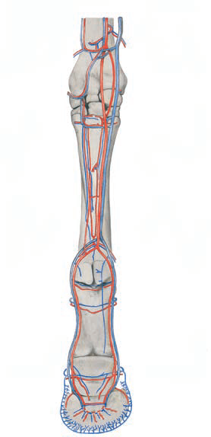
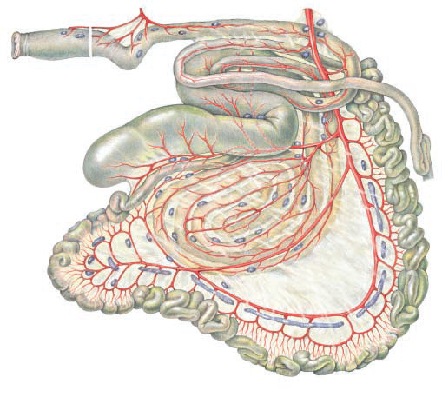
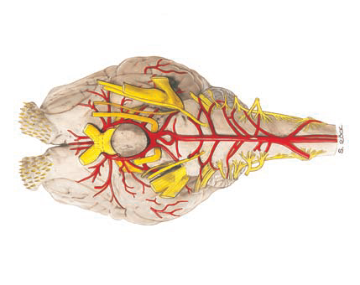
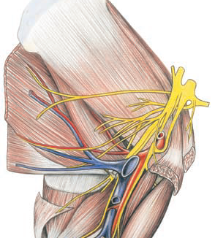
(5) Angiology: It deals with the description of organs of circulation of blood and lymph.
(6) Neurology: (Neuron: Nerve): It deals with the description of nervous system

Slide 16
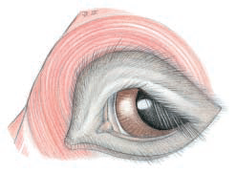
(7) Aesthesiology: It deals with the description of sense organs and common integument.

Slide 17
(b) Topographic or Regional:
In topographic method of study the animal body is divided into following regions:
Head
Neck
Thorax
Abdomen
Pelvis
Forelimb
Hind limb
Tail
In this method of study:
Relative positions or various parts of body are accurately determined.
The different structures are investigated in order in which they present themselves during dissection
as the different structures lie in relationship with one another in different regions of the body.
This method of study requires a fair working knowledge of systematic anatomy.

Slide 18
Class-II

Slide 19
Topographic Terms
Planes –
Surfaces-

Slide 20
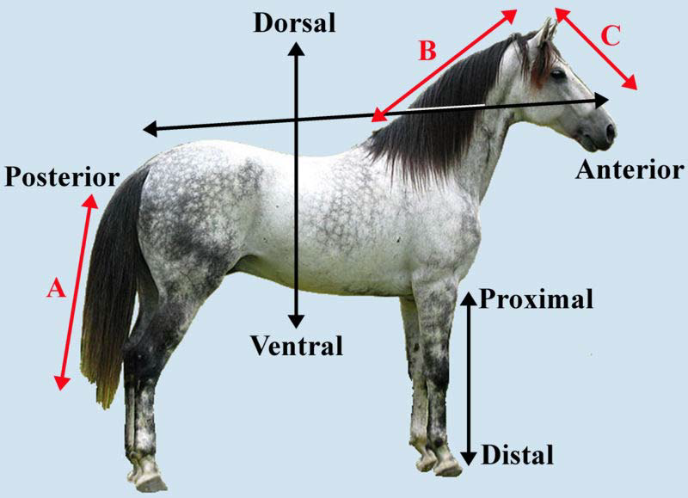
Topographic Terms
In order to indicate clearly the position and direction of different parts of animal body, certain descriptive terms are used. In the explanation of these terms it is assumed that they apply to a quadruped such as the ox in the ordinary standing position.
The surface directed towards the ground is termed ventral (or inferior) and the opposite surface is dorsal (or superior) ; the relations of parts in this direction are named accordingly.

Slide 21
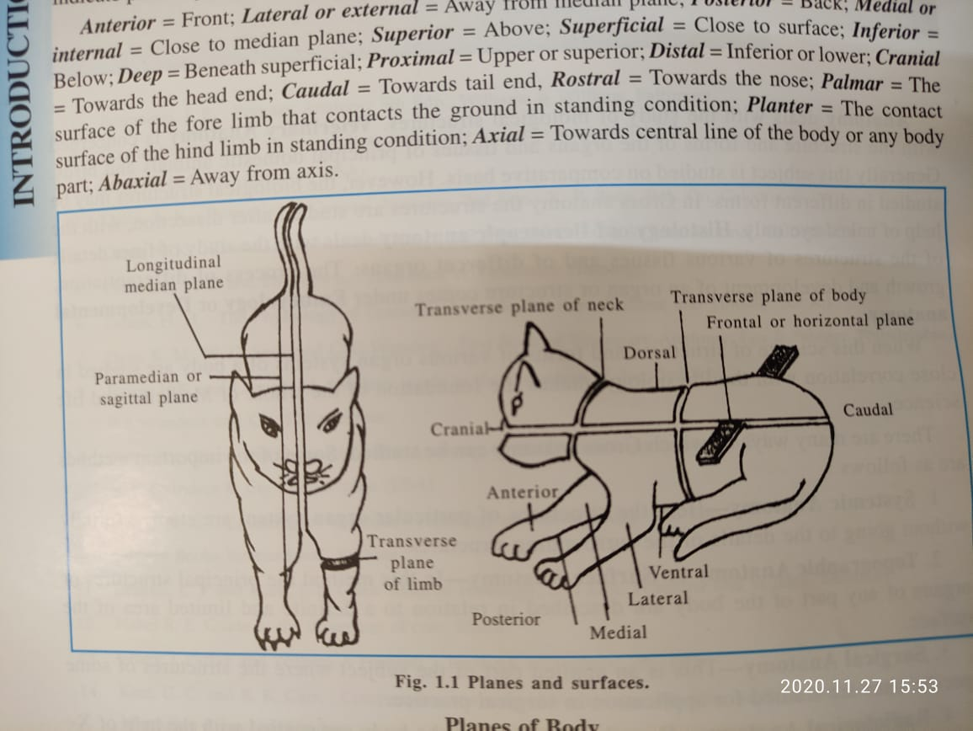
Planes of body (4)
A plane extending through the length of the body dividing it into similar halves is known as median or mesial plane.
A structure or surface which is nearer than another to the median plane is medial (or internal) to it, and an object or surface which is farther than another from the median plane is lateral (or external) to it.
Planes parallel to the median plane are sagittal.
Transverse or segmental plane cuts the long axis of the body perpendicular to the median plane, or an organ or limb at right angles to its long axis.
A frontal plane is perpendicular to Median and transverse planes.

Slide 22
Head end of body is termed cranial or anterior and tail end caudal or posterior.
Relations of structures with regard to longitudinal axis of body are designated accordingly.
Superficial and deep terms are useful to indicate relative distances from surface of the body.
Certain terms are used in a special sense as applied to the limbs-
Proximal (Nearer to) and distal (farther away) are used to indicate relative distance from the long axis of the body.
Cranial face of the distal part of the thoracic limb (below the carpus) is termed dorsal and the opposite face Palmer.
In the corresponding parts of the pelvic limb (below the tarsus) the terms are dorsal and plantar, respectively.

Slide 23
Osteology (General)
Skeleton – is frame work of hard structures which supports and protects the soft tissues of animals.
It is of two types-
i)Exoskeleton- present externally on the body and includes feathers, hair and hoofs of the higher vertebrates
ii) Endoskeleton - embedded in the soft tissues and consists of three parts:
(1) Axial skeleton consists vertebral column, ribs sternum and the skull.
(2) Appendicular skeleton -skeleton of limbs
(3)Splanchnic skeleton- consists bones present in some of visceral or soft organs, e.g. ospenis in dog, oscordis in ox, osphrenic in camel, and os rostri in pig,osopticus in fowl etc.

Slide 24
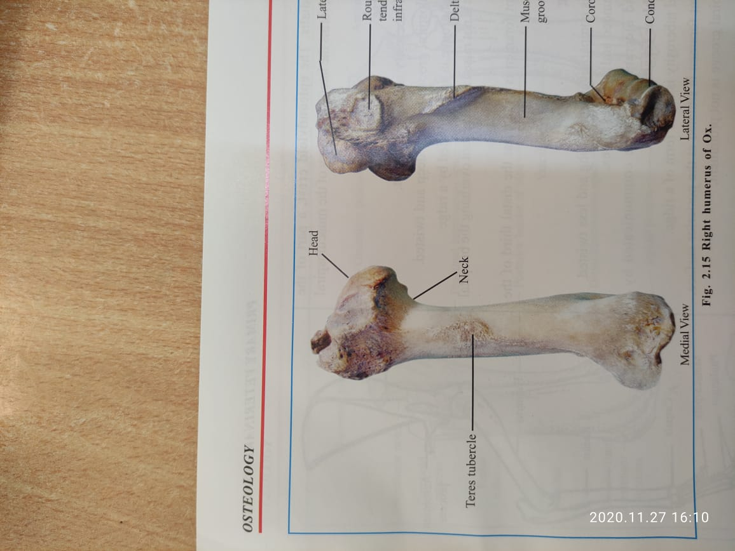
CLASSIFICATIONS OF BONES
On the basis of their shape and function the bones are of the following four types:
1- LONG BONES: e.g. Humerus, radius, femur, tibia etc.
These consist a medullary or marrow cavity.
Their length is considerably more than breadth and thickness.
These have a shaft or body and two extremities. The former have a cylindrical bony covering which encloses the medullary cavity.
They are present in the limbs only.
Functions-
Bearing of weight
To provide levers necessary for locomotion.

Slide 25
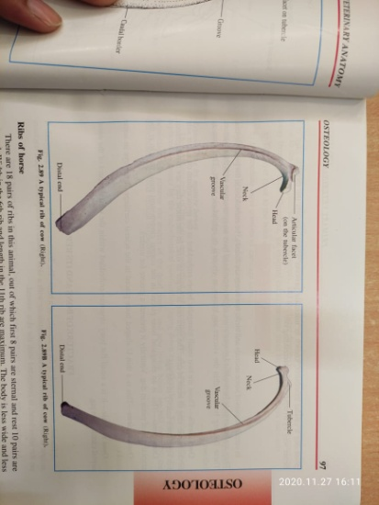
ELONGATED BONE:
Like a long bone it is notably expanded in one dimension so that its length considerably exceeds its breadth or thickness
But it has no marrow cavity.
Thus it does not strictly conform to the definition of a long bone, e.g. ribs.

Slide 26
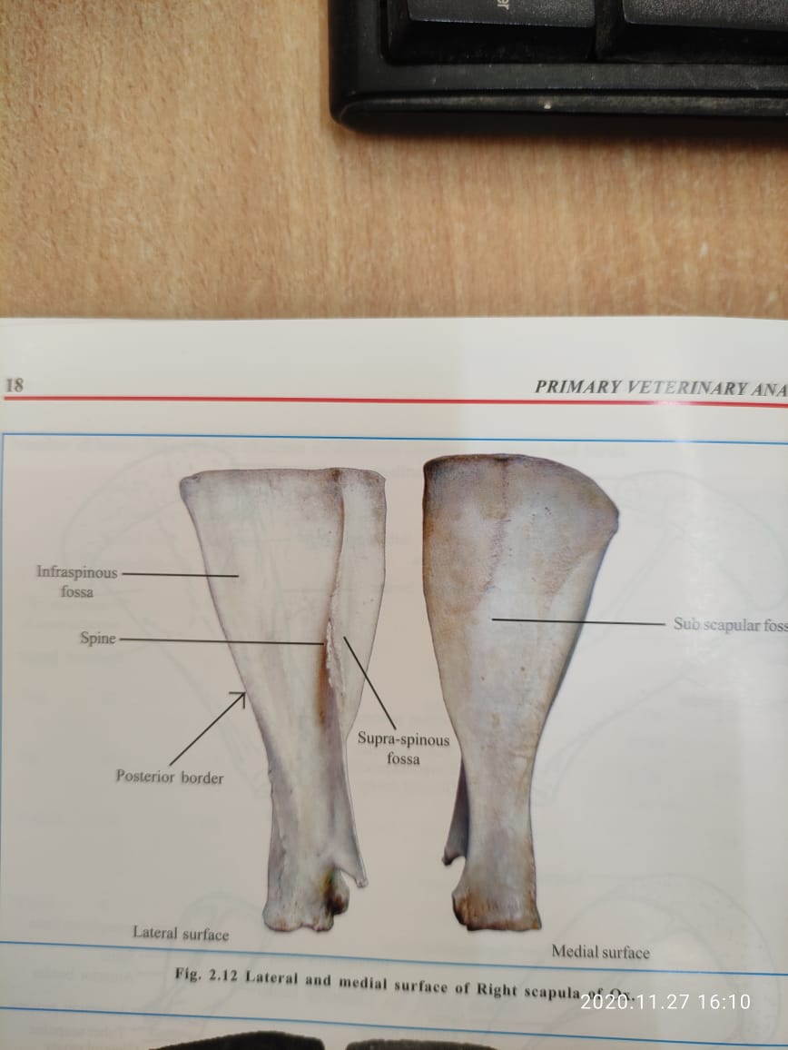
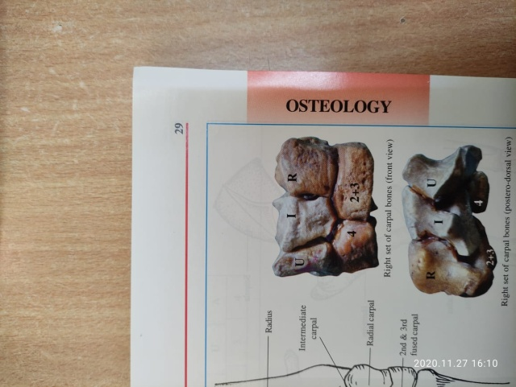
(2) FLAT BONES: It is expanded in two dimensions in excess of the third (i.e. both length and breadth are bigger than thickness) and is, therefore, more or less plate like.
FUNCTIONS:
(i) To give more surface for attachment of muscles (e.g. scapula),
(ii) To give protection to underlying structure (e.g. Frontal bone of skull).
(3) SHORT BONES:
Comparatively small size which presents somewhat similar dimensions in length, breadth and thickness, e.g. bones of carpus.
FUNCTION: The collection of short bones diminishes the risk of injury from concussion as multiple joints formed between the bones serve to distribute weight and pressure of concussion.

Slide 27
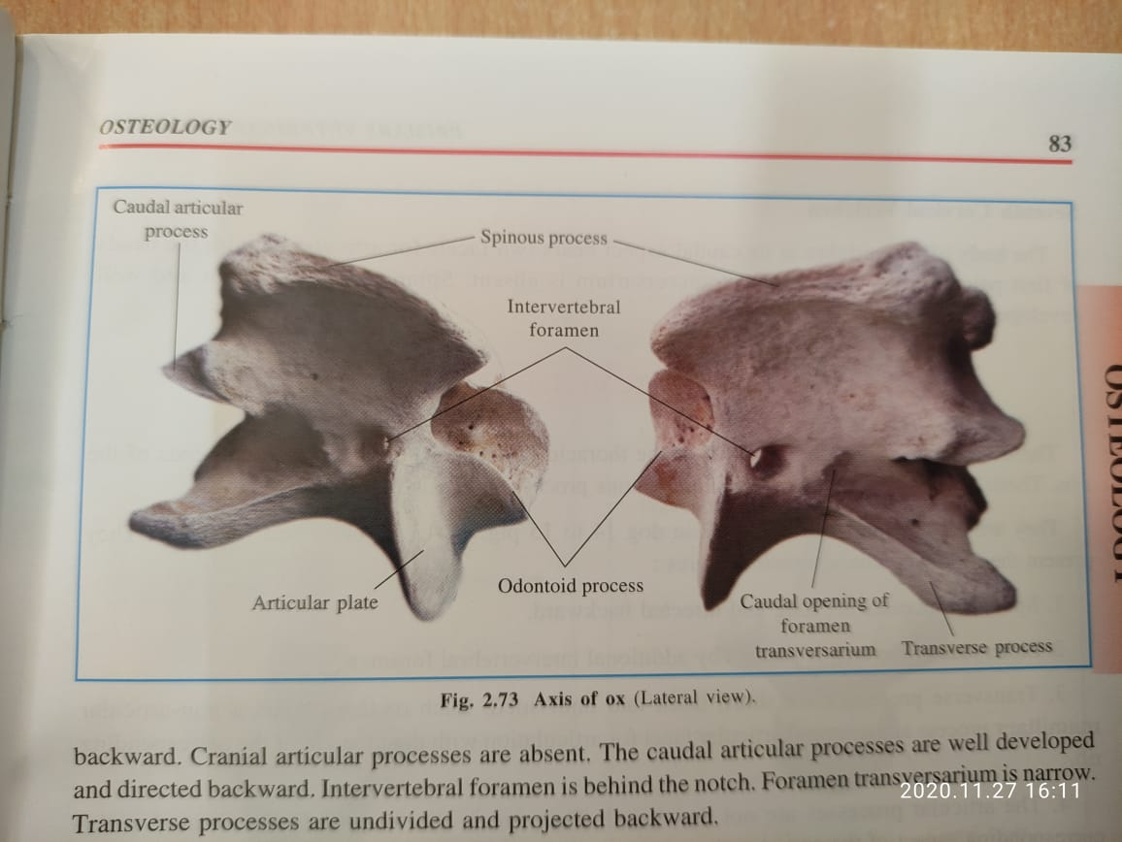
(4) IRREGULAR BONES: It is an unpaired bone of skeleton which is very irregular in shape due to the processes which are distributed over its surface. It is placed on the median line of skeleton, e.g. bones of vertebral column.
FUNCTIONS:
(i) To furnish attachment to muscles and ligaments by its processes.
(ii) To enclose important structures.

Slide 28
Class-III

Slide 29
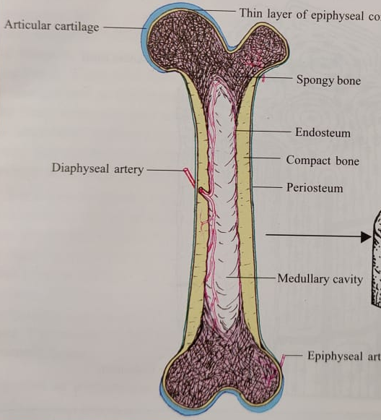
STRUCTURE OF BONES
Bones consist chiefly of bony tissue, but considered as organs, they present also an enveloping membrane, termed the periosteum, the marrow, vessels, and nerves.
The architecture of bone can be studied best by means of longitudinal and transverse sec­tions of specimens which have been macerated so as to remove most of the organic matter.
These show that the bone consists of an external shell of dense compact substance, within which is the more loosely arranged spongy substance.
In typical long bones the shaft is hollowed to form the medullary cavity.

Slide 30
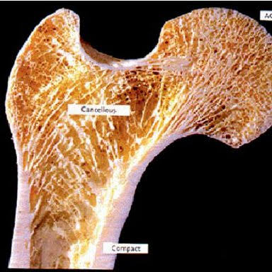
THE COMPACT SUBSTANCE
Differs greatly in thickness in various situations, in conformity with the stresses and strains to which the bones is subjected.
In the long bones it is thickest in or near the middle part of the shaft and thins out toward the extremities.
On the latter the layer is very thin, and is specially dense and smooth on joint surfaces.

Slide 31
THE SPONGY SUBSTANCE
Consists of delicate bony plates and spicules which run in various directions and intercross.
The disposition of the plates of the spongy substance is claimed to correspond to, the lines of pressure and tension inmost of the bones.
The intervals between the plates are occupied by marrow and are termed marrow spaces.
The spongy sub­stance forms the bulk of short bones and of the extremities of long bones; in the latter it is not confined to the ends, but extends a variable distance along the shaft also.
Some bones contain air-spaces with the compact substance instead of spongy bone and marrow, and hence, are called pneumatic bones. These cavities are termed sinuses and are lined with mucous membrane; they communicate indirectly with the external air.

Slide 32
The flat bones of cranial vault have very dense outer and inner tables (Lamina externa, interna) of compact substance and intermediate layer of spongy substance; the latter is channeled with large veins and is known as the "diploe"
THE PERIOSTEUM:
is the membrane which invests the outer surface of bone, except where it is covered with cartilage.
It consists of an outer protective "fibrous" layer, and an inner cellular "osteogenic" layer.
During active growth, the "osteogenic" layer is well developed but later it becomes much reduced.
THE ENDOSTEUM
thin fibrous membrane which lines the medullary cavity and the larger Haversion canals.
THE MARROW:
Occupies the marrow spaces and the medullary cavity.
There are two varieties in the adult red and yellow.
In young subject there is only red marrow, but later this is replaced in the medullary cavity by yellow marrow
In the healthy adult, red marrow is found only in the vertebrae, the ribs, the sternum, the diploe of the bones of the skull and in the proximal epiphyses of the femur and humerus.

Slide 33
VESSELS AND NERVES
Consist two sets of arteries - the periostieal and the medullary.
Former ramifies in periosteum and give off innumerable small branches which enter minute openings (Volkmann's canals) on surface and reach the Haversian canals of the compact substance.
Other branches enter the extremities of long bones and supply spongy bone and marrow.
In larger bones and especially long bones large nutrient or medullary artery enters at so called nutrient foramen, passes in a canal through compact substance, and ramifies in the marrow,
Larger veins of the spongy bone do not accompany the arteries, but emerges chiefly near the articular surface.
Lymphatic vessels are abundant in the periosteum, and peri vascular lymphatics are present in the Haversian canals.
Nerves appear to the distributed chiefly to the blood vessels.
Special nerve endings in the periosteum are to be regarded as sensory, and probably are concerned in mediating the muscle sense.

Slide 34
PHYSICAL PROPERTIES OF BONE
It is one of the hardest structures of animal body, though it possesses some toughness and elasticity as well.
In fresh state it is yellowish white externally and deep red within.
When exposed in living body the white is tinged with bluish pink due to blood contained in the vessels of the bone.
When bone is macerated or boiled and bleached it is white.
The specific gravity of fresh compact bone is about 1.9.­
CHEMICAL COMPOSITION OF BONE
Bones are composed of solids and water. The amount of water in fresh bone varies from 25 to 50 per cent.
A dried, marrow-free bone consists, of both organic and inorganic matters in the ratio (approximately) 1 : 2.
The former gives toughness and elasticity whereas the latter gives hardness and rigidity to bone.

Slide 35
By burning a bone in a furnace the whole of the organic matter is consumed, and it becomes white and chalky. In the process of combustion the bones loose about one-third of its weight, and it becomes completely deprived of its elasticity.
By prolonged boiling of bones most of the organic matter can be extracted in the form of gelatin.
By steeping a bone in dilute solution of hydrochloric acid the inorganic salts can be dis­solved out, the bone in the process losing about two-thirds of its weight. At the same time the rigidity and weight supporting power of the bone are lost, and it becomes supple and pliable.

Slide 36
Following is chemical composition in 100 parts of dried, marrow free bone-
Organic matter in the form of Gelatin 33.30 Parts
Inorganic matter 66.70 Parts
Calcium phosphate 57.35
Calcium carbonate 3.85
Magnesium phosphate 2.05
Sodium chloride and
Sodium carbonate 3.45
Total 66.70
Grand Total 100.00

Slide 37
Descriptive /Essential Terms
It is essential to know about the certain terms used to describe various prominences and depressions present on the surface of bones.
Both of these are articular and non-articular types.
Articular Prominences
Head : A rounded articular enlargement at the end of a bone is called as head. It is connected to the body of the long bone by a constricted part termed as 'neck' e.g., Head of humerus.
Condyle: is a large, rounded, somewhat cylindrical articular prominance, e.g., condyle of humerus.
Trochlea: is a pulley -like articular mass, e.g., Trochlea of femur.
Facet: is a small, usually flattened, articular surface e.g., costal facet.

Slide 38
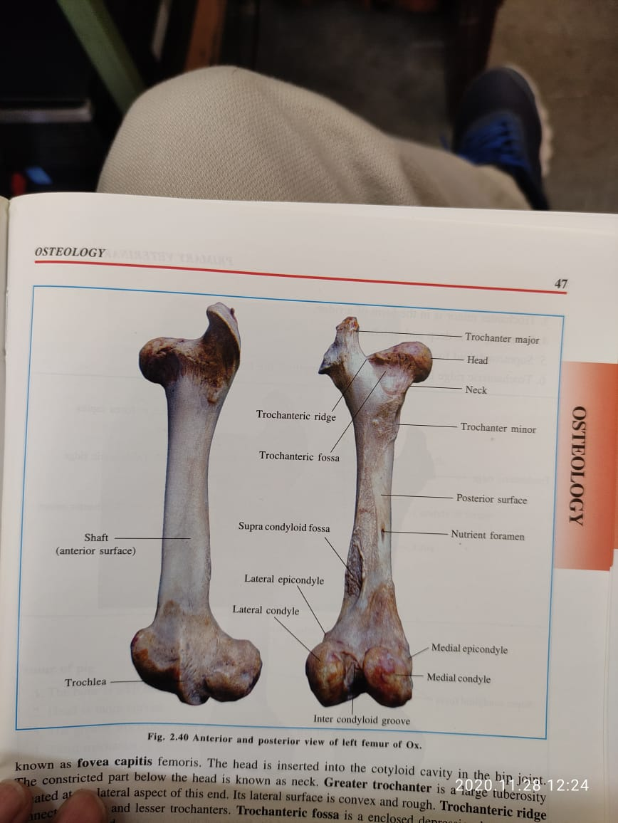
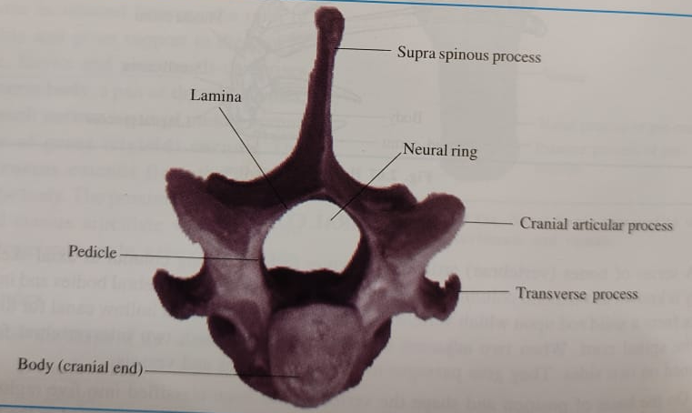

Slide 39
Non-articular prominence
1. Process: is the general term for a non-articular localized elevation or prominence on a bony surface, e.g., coracoid process of scapula.
2. (A) Ridge: is a non-articular extended elevation on a bony surface, e.g., trochanteric ridge.
(B) Line: is a very small non-articular low and narrow ridge, e.g., Gluteal line.
(C) Spine: is a sharp non-articular often pointed protection, e.g., spine of scapula.
3. (A) Tubercle: is a small, rounded, non-articular projection which may be either Smooth or rough. It is smaller than a tuberosity, e.g., teres tubercle.
(B) Tuberosity: is a large, rounded, non-articular projection which may be either rough or smooth. It is bigger than a tubercle but smaller than a trochanter, e.g., deltoid tuberosity.
(C) Trochanter: is the largest variety of non-articular prominence which may be smooth or rough. It is bigger than tuberosity, e.g., trochanter major.

Slide 40
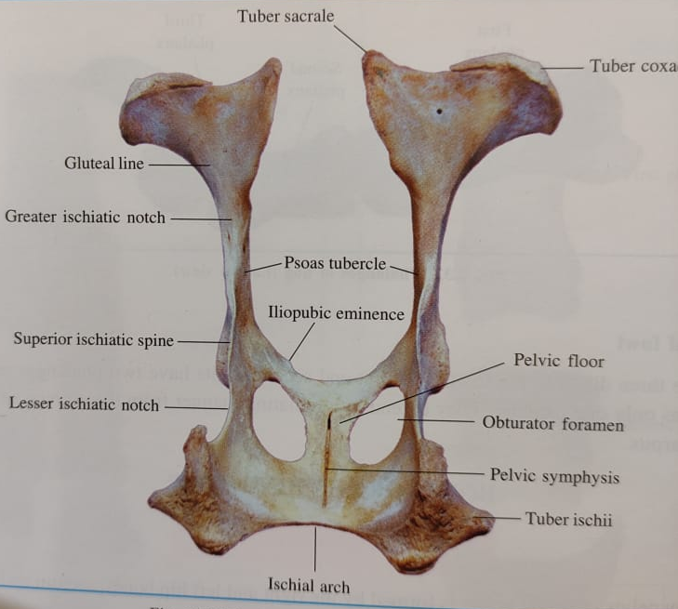
Greater
trochanter
Teres tubercle
Deltoid
tuberosity

Slide 41
Articular depressisons
(1) Glenoid cavity: is an oval, shallow articular depression e.g., glenoid cavity of scapula.
(2) Cotyloid cavity: is a deep, articular depression, e.g., cotyloid cavity of os­ coxae.
Non-articular depreesions
(1) Fossa: is a non-articular depression, e.g. olecranon fossa.
(2) Fovea: is a non-articular depression smaller than a fossa, e. g., fovea capitis.
(3) Notch or incisura: is a short but deep non-articular depression, e.g. acetabular notch.
(4) Groove or sulcus: is a non-articular groove or furrow, e.g. Bicipital groove.
(5) Foramen: It is a perforation or opening in a bone for the passage of blood vessels and nerves, e.g. nutrient foramen.
(6) Pneumatic foramen: is an opening in a bone which gives passage to air e.g., in humerus of fowl.
(7) Canal: It is a narrow passage leading from a foramen, e.g. facial canal.
(8) Sinus: is an air cavity within a bone or bones; it is lined with mucous membrane and communicates with exterior, e.g. frontal sinus.

Slide 42
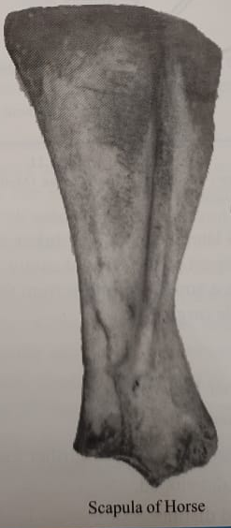
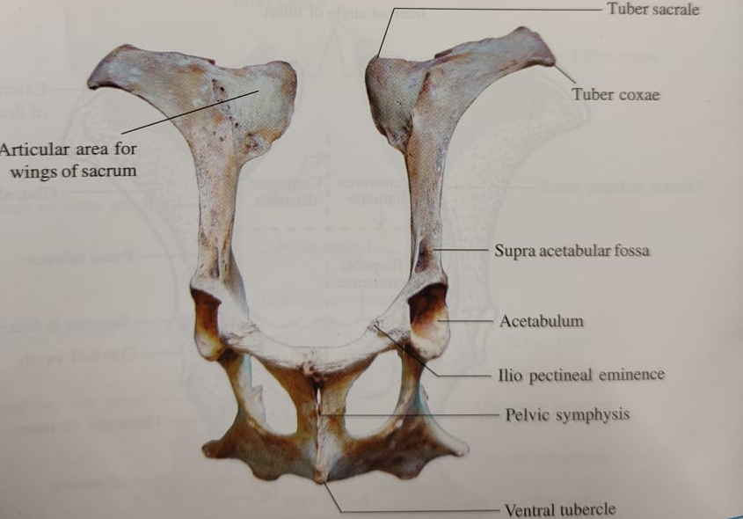

Slide 43
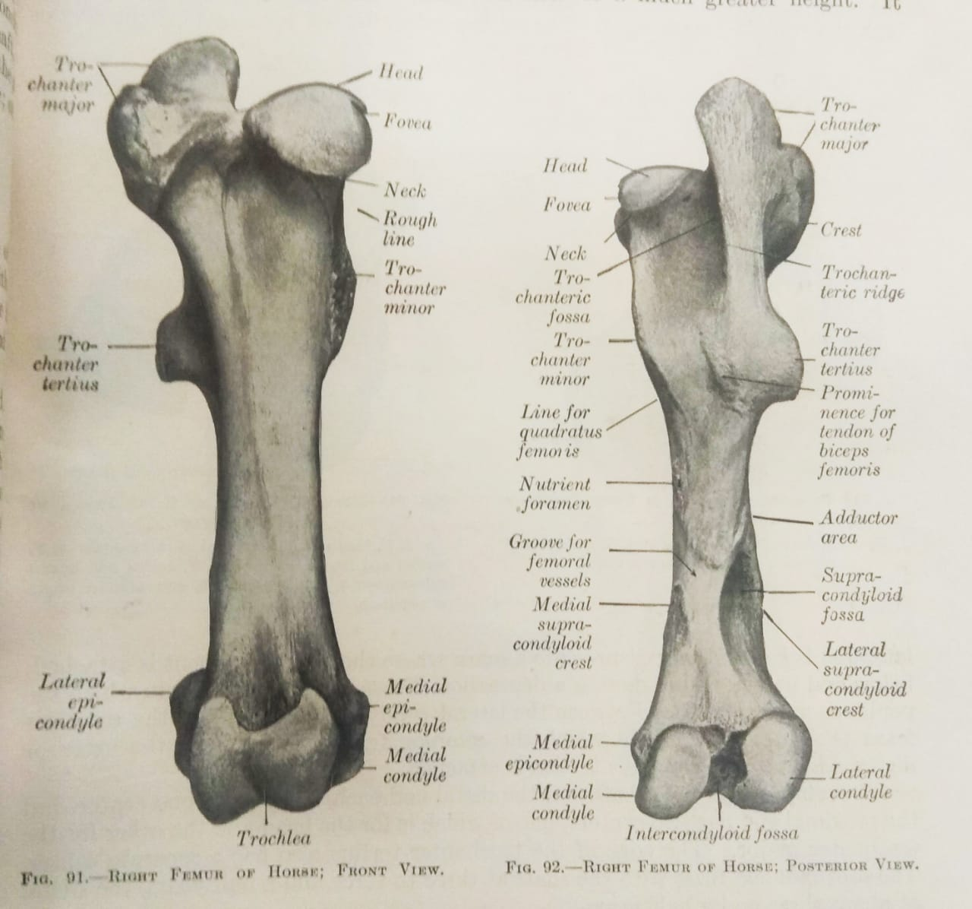
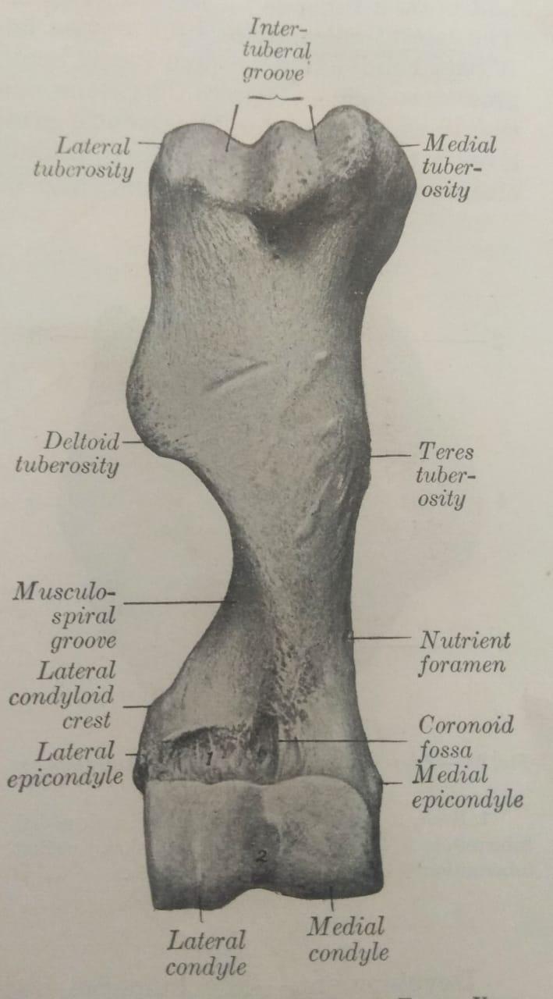
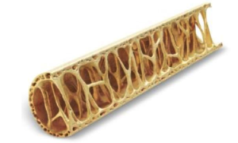
Pneumatic bone

Slide 44
Types of Anatomy
Anatomy could be classified into:
1. Human Anatomy – Human anatomy involves the study of the physical structure of the human body.
2. Plant Anatomy – Also called the phytotomy. It is the study of the internal structure of a plant.
3. Animal Anatomy – Also called the zootomy. It deals with the study of the internal structure of an animal including the cells, tissues, organs, bones and other organs of the animal body.

Slide 45
Anatomy is classified into:
1. Gross Anatomy (Macroscopic anatomy).
2. Microscopic Anatomy (Histology)

